Slide 1
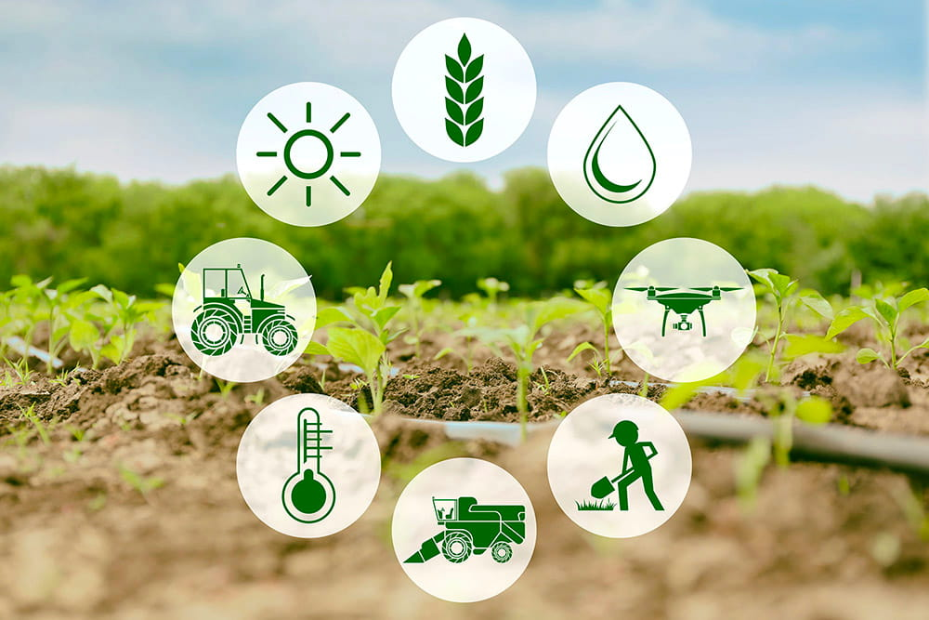
India Agriculture Crop Production Analysis

Slide 2
GOVINDAMMAL ADITHANAR COLLEGE FOR WOMEN TIRUCHENDUR
III BSC MATHAMETICS
TEAM MEMBERS
J.MARIA ESTHER MELOSHA
S.DEVATHARSHINI
A.GLADISH
S.JANANI

Slide 3
CONTENTS
INTRODUCTION
PROBLEM DEFINITION &DESIGN THINKING
RESULT
ADVANTAGES
DISADVANTAGES
APPLICATIONS
CONCLUSION
FUTURE SCOPE
APPENDIX

Slide 4
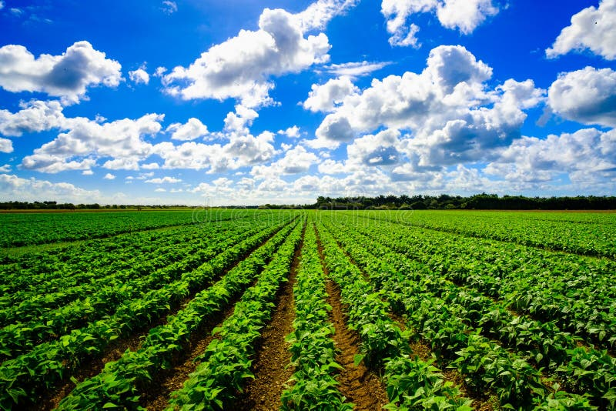
INTRODUCTION
OVERVIEW
As per the 2014 FAO world agriculture statistics India is the world’s largest producer of many fresh fruits like banana, mango, guava, papaya, lemon and vegetables like chickpea, okra and milk, major spices like chili pepper, ginger, fibrous crops such as jute, staples such as millets and castor oil seed. India is the second largest producer of wheat and rice, the world’s major food staples.
India exported $39 billion worldwide and the 6th largest net exporter. This represents explosive growth, as the fastest growing exporter of agriculture products over 10 years period, its $39 billion of net export is more than double the combined exports of the European Union.

Slide 5
India has shown a steady average national wide annual increase in the mass reduced per hectare for some agricultural items, over the last 60 years. These gain have come mainly from India’s green revolution, improving road and power generation infrastructure, knowledge of gains and reforms. Despite these recent accomplishments, agriculture has the potential for major productivity and total output gains, because crop yield in India are still just 30% to 60% of the best sustainable crop yields achievable in the farms if developed and other developing countries.

Slide 6
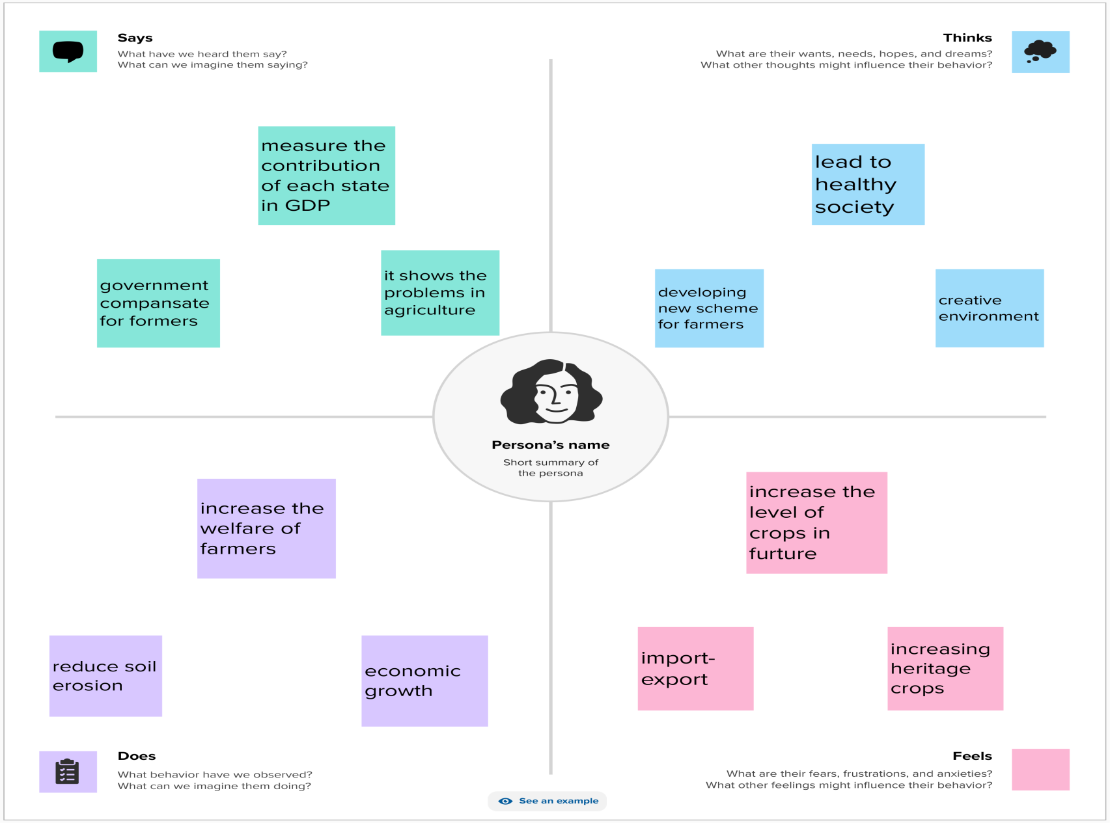
PROBLEM DEFINITION &DESIGN THINKING

Slide 7
EMPATHY MAP
SAYS
Measure the contribution of each state in GDP
Government compensate for formers
It shows the problem in agriculture
THINK
Lead to health society
Developing new scheme for formers
Creative environment

Slide 8
Does
Increase the welfare for formers
Reduce soil erosion
Economical growth
Feels
Increase the level of crops in future
Import – Export
Increasing heritage crops

Slide 9
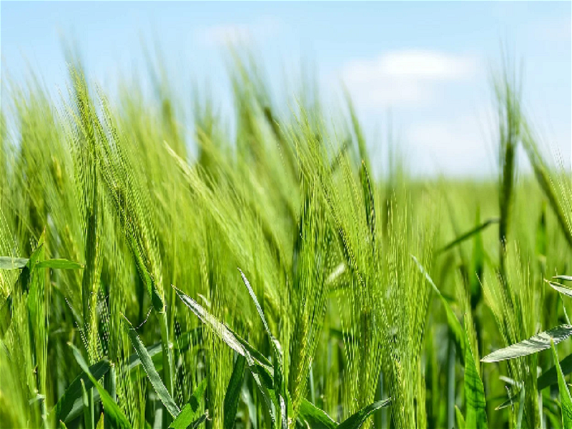

IDEATION & BRAINSTORMING MAP

Slide 10
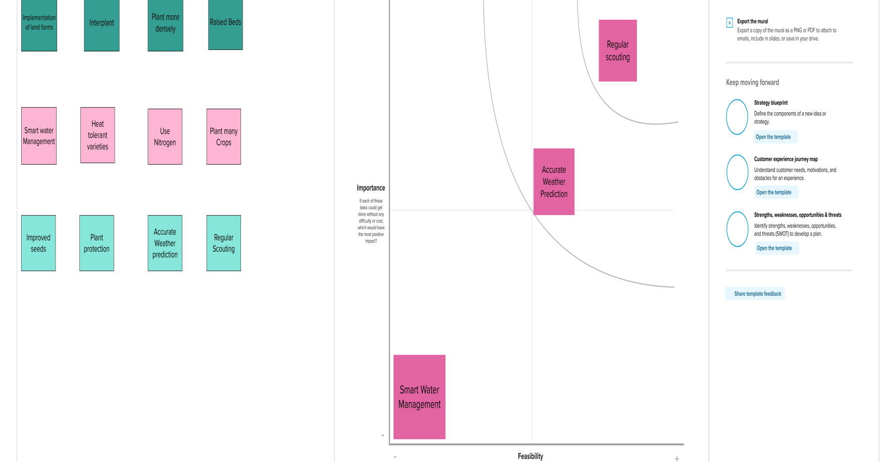
BRAINSTORMING MAP

Slide 11
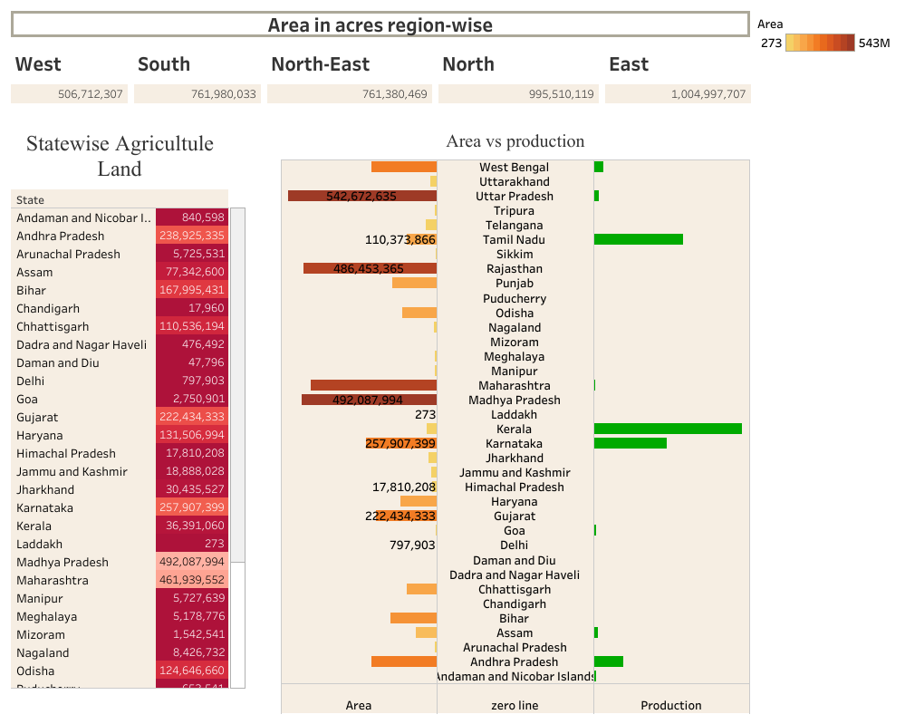
Result

Slide 12
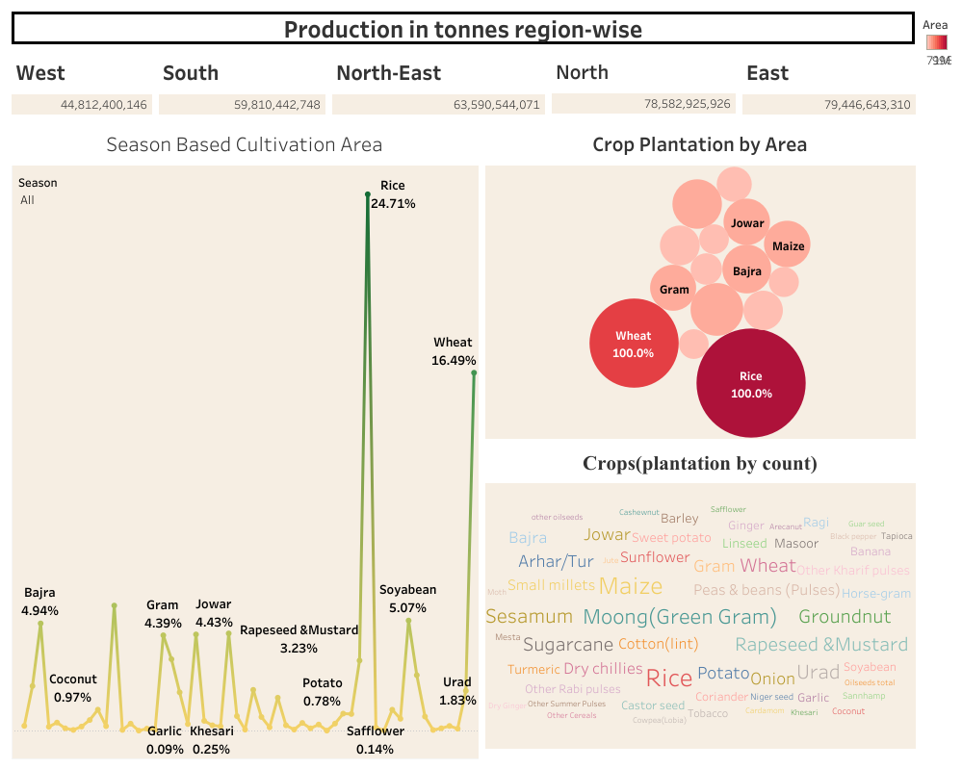
Dashboard

Slide 13
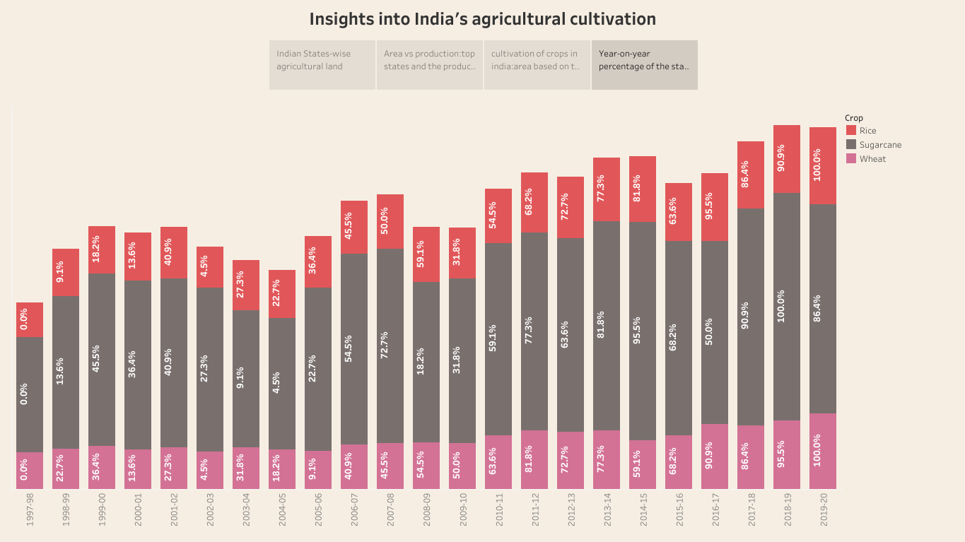
Story 1

Slide 14
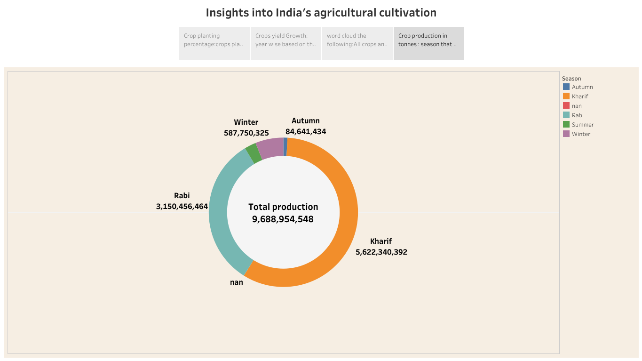
Story 2

Slide 15
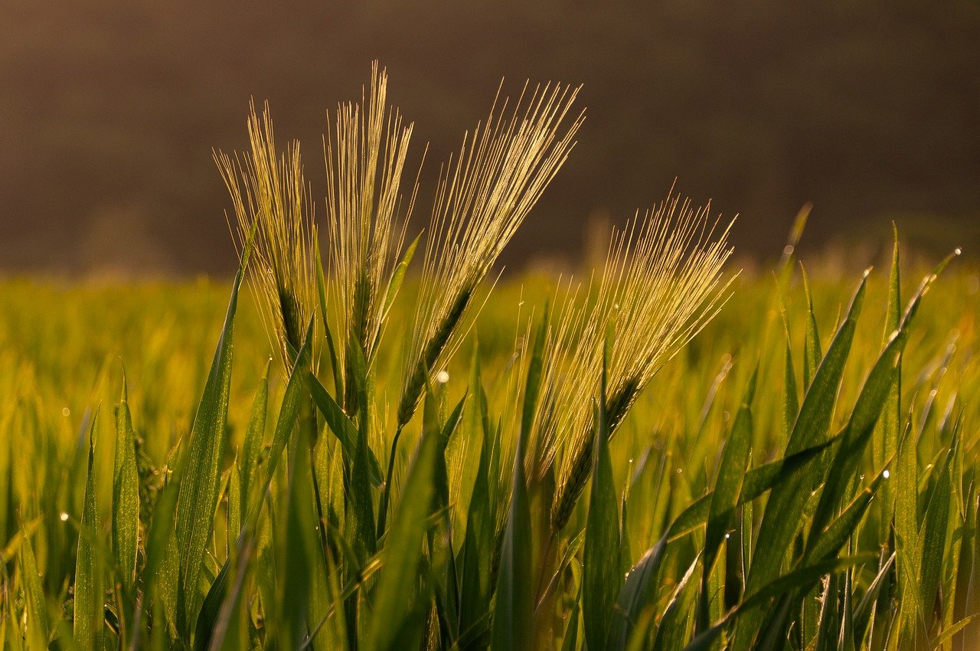
Advantages of indian agricultural crops
Increased Efficiency- Modern farming methods are more efficient than traditional methods, with advanced machinery and equipment, allowing farmers to produce large quantities of crops in less time and with less labor.
IMPROVED CROP QUALITY- the use of advanced techniques such as precision farming and genetic engineering has led to the development of higher quality crops that are more resistant to pests and disease.
Reduced environmental impact- modern agriculture techniques are designed to be more sustainable, with a focus on reducing waste, conserving resources, and minimizing the use of harmful chemicals.

Slide 16
4. Increased food production- modern agriculture has enabled farmers to produce large quantities of food, helping to address food shortages and hunger in many parts of the world.
5. Economic benefits - modern agriculture has a positive impact on the economy, by creating jobs and generating revenue for farmers, agribusinesses, and related industries.

Slide 17
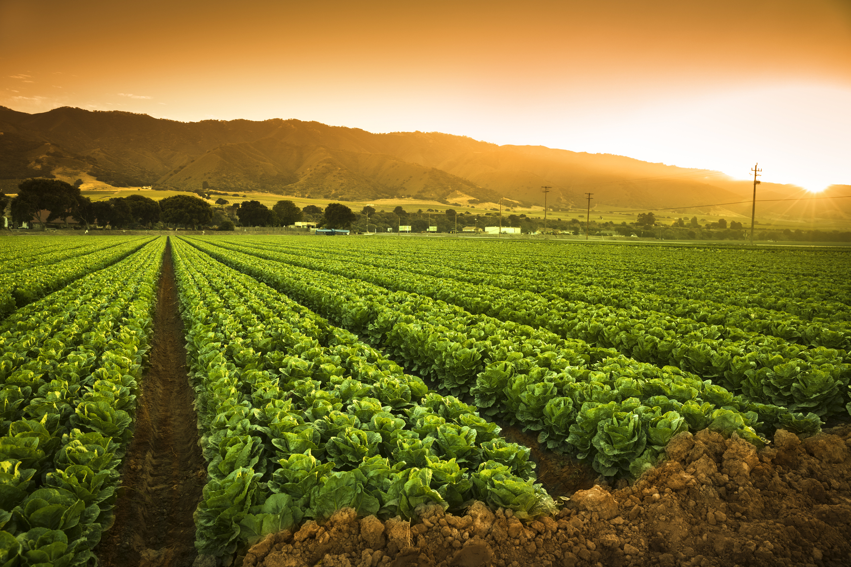
Disadvantages of indian agricultural crops
Soil degradation- the intensive use of modern farming practices, such as heavy use of chemicals fertilizers and pesticides, can lead to soil degradation over time, reducing soil fertility and leading to erosion.
Biodiversity loss- modern agriculture can have a negative impact on biodiversity, with the use of monoculture and genetically modified crops leading to a loss of natural diversity in plant and animal species.
Water pollution- the excessive use of chemical fertilizers and pesticides in modern agriculture can lead to runoff and contamination of nearby water sources, potentially harming aquatic ecosystems and human health.

Slide 18
conclusion
India has always been benefited by Agriculture.
Thus, the agricultural sector is playing a very important role in the country like India and the prosperity of the Indian Economy still largely depends on agricultural sector.
Agricultural development is the basic pre condition of sector diversification and development if the economy.

Slide 19
Future scope
Agriculture provides various employment opportunities.
Its importance because food and food products are indispensible for survival of humanity.
Globalization effects will increase demand for food.

